Slide 1
Wait to Be Done
Need to Be Revised
Step 1: Biosolids Application Simulation
Step 3: Refine Pharmacokinetic Model
Biosolids
Soil
Plant
Animal
Human
corn, grass, etc.
swine, cattle etc.
Step 2: Diet Composition and Bioaccumulation Literature Review
Step 4: Estimate Daily Intake
Notes:
https://doi.org/10.1016/j.fct.2023.114062

Slide 2
Biosolids
Biosolids Loading Rate (Mg/ha)
Step 1: Biosolids Application Simulation*
Linear model
Topsoil
Soil Concentration (ng/g)
(Top 30 cm)
Simulation by HYDRUS
(Linear model)
Leaching from Topsoil
Leachate Concentration (ng/L)
Dilution Attenuation Factors
Groundwater
Groundwater Concentration (ng/L)
Groundwater
* Sepulvado et al., 2011
Notes:
* Sepulvado et al., 2011

Slide 3
Biosolids
Biosolids Loading Rate (Mg/ha)
Linear model
Topsoil
Soil Concentration (ng/g)
(Top 30 cm)
Simulation by HYDRUS
(Linear model)
Leaching from Topsoil
Leachate Concentration (ng/L)
Dilution Attenuation Factors
Groundwater
Groundwater Concentration (ng/L)
Groundwater
* Sepulvado et al., 2011
Notes:
Step 1, Step 2, Step 3.

Slide 4
Step 1: Biosolids Application Simulation*
(Top 30 cm)
Biosolids data
Soil sample data
biosolid-augmented agricultural soil from the Great Lakes basin of North America (Chu et al., 2017)
7 soil samples from our previous studies
Groundwater

Slide 5
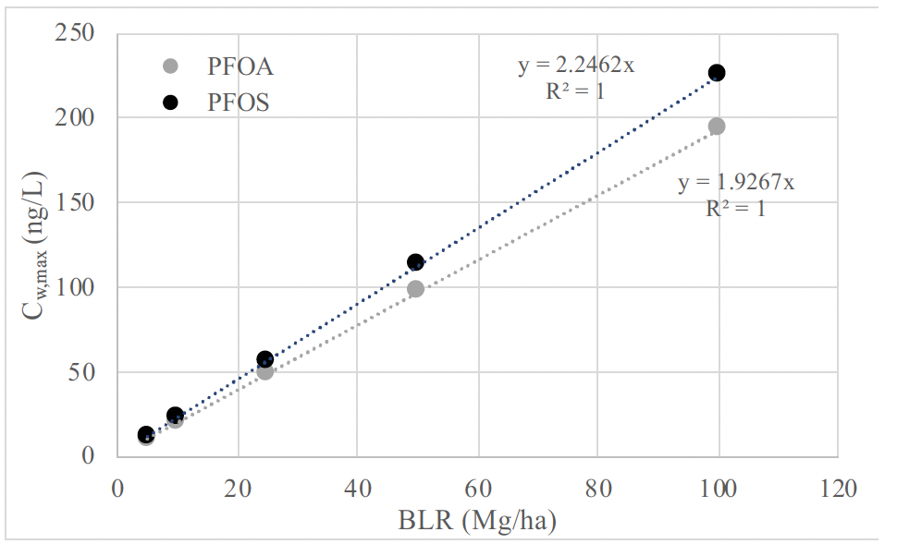
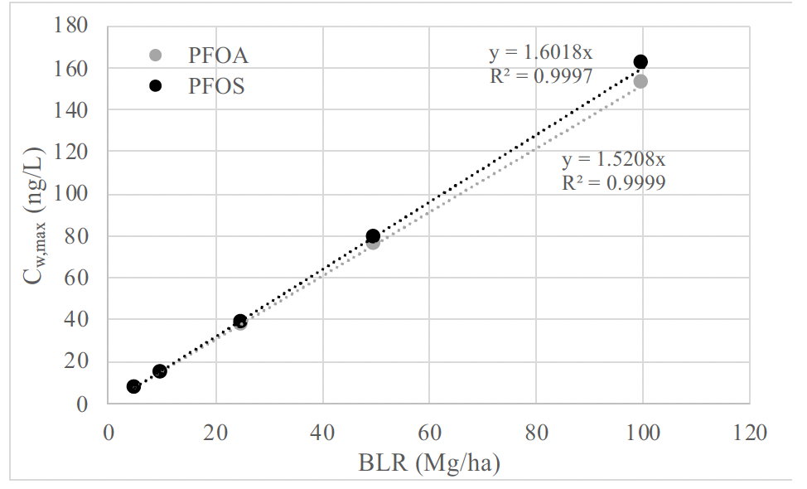
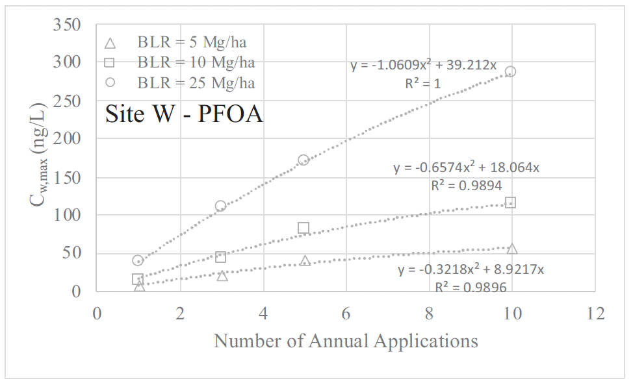
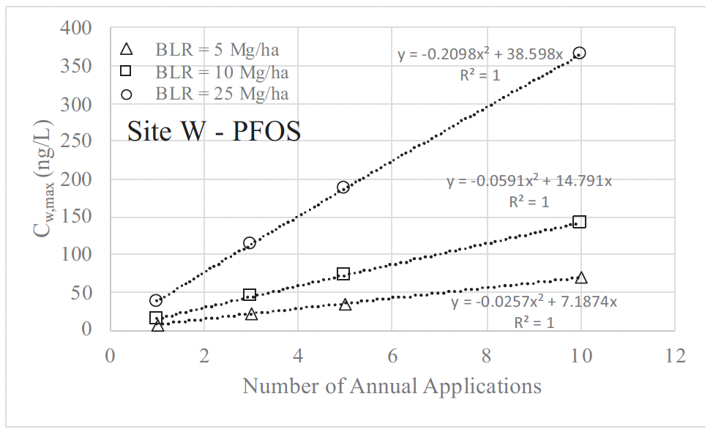
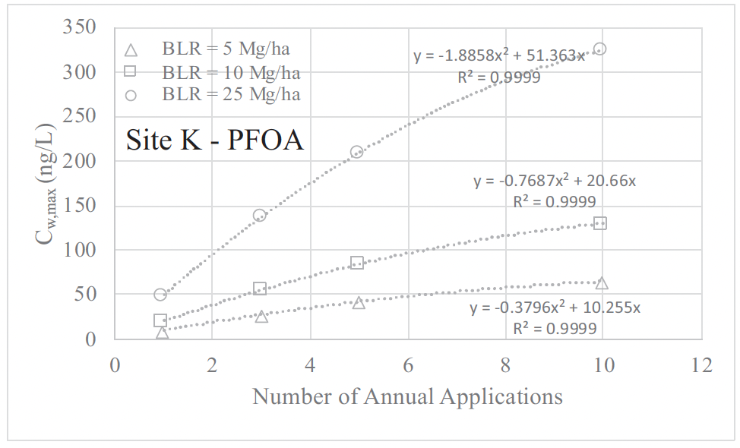
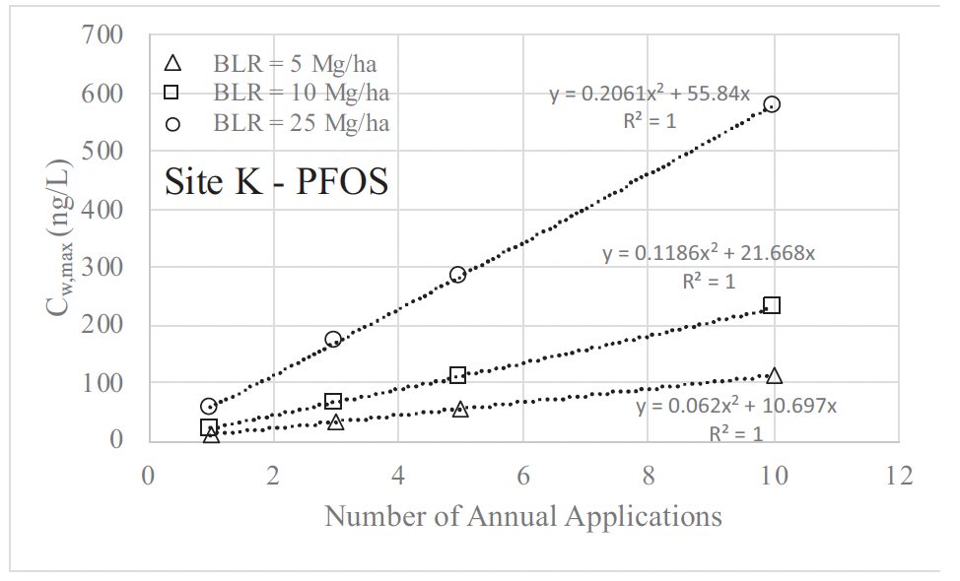
Single Application
Monitoring point 1
(Top 30 cm)
Monitoring point 2
heterogeneity
homogeneity
Multiple
Applications

